Slide 1
Covid-19 Effects and Projections
Project 1 - Team 1
Tom Babjak
Fleming Brathwaite
Alexander Gonzalez
Mona Peteet
February 2021

Slide 2
Motivation & Summary
Hypothesis
If the covid pandemic affected the travelling economy then a decrease in mobility across various forms of transportation would be expected.
Exploration
Seeking to analyze the economic impacts resulting from the pandemic in order to assess household income and travel spending impacts.
To review the travel implications and understand if the impacts were experienced across various forms of transportation, to determine if a particular form of travel was more affected than the other.
Based on current trends in air-travel, what was the effect of COVID-19 in 2020, and when can we predict a return to ‘normalcy’?
Observations
The resulting analysis demonstrated sharp declines after February 2020 for data analyzed in the areas of mobility.
There is a decrease in unemployment claims starting Fall/Winter 2020. The causal factors were not explored as part of this project’s analysis.
Impacts were slightly varied between states but some similarities exist.

Slide 3
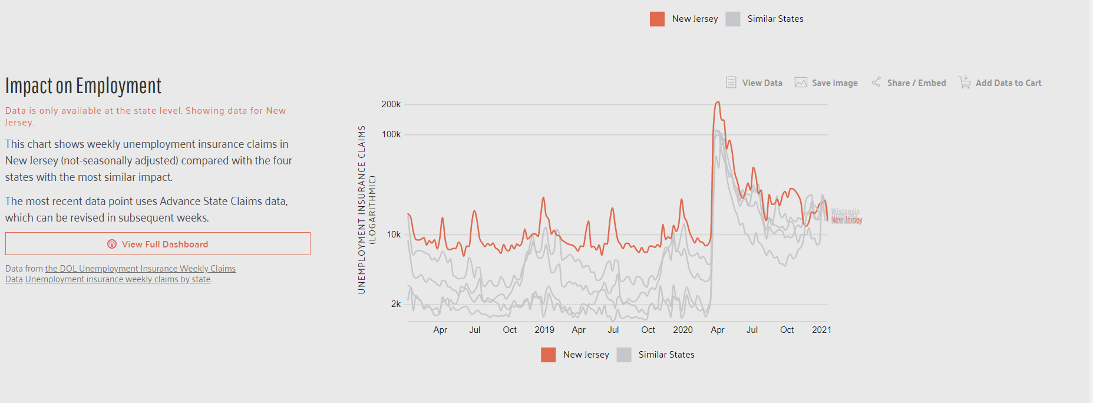
Employment Coverage
1.https://datausa.io/profile/geo/new-jersey#:~:text=Median%20Household%20Income,-%2481%2C740&text=Households%20in%20New%20Jersey%20have,represents%20a%202.06%25%20annual%20growth.

Slide 4
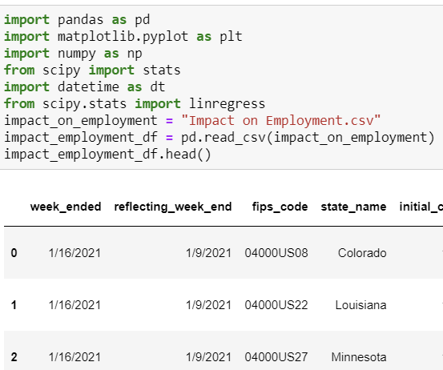
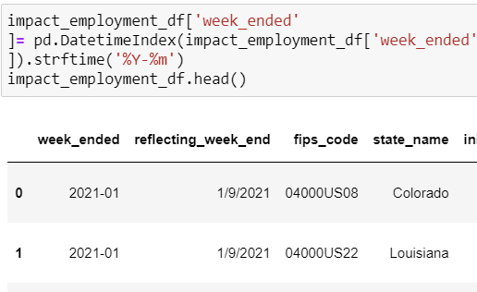
Impact on Employment Data Organizing

Slide 5
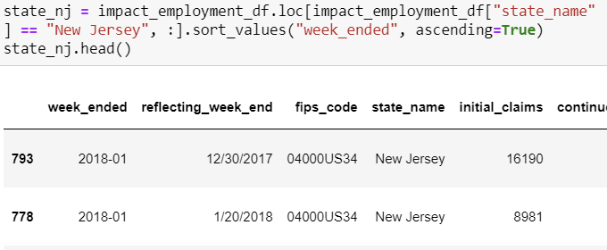
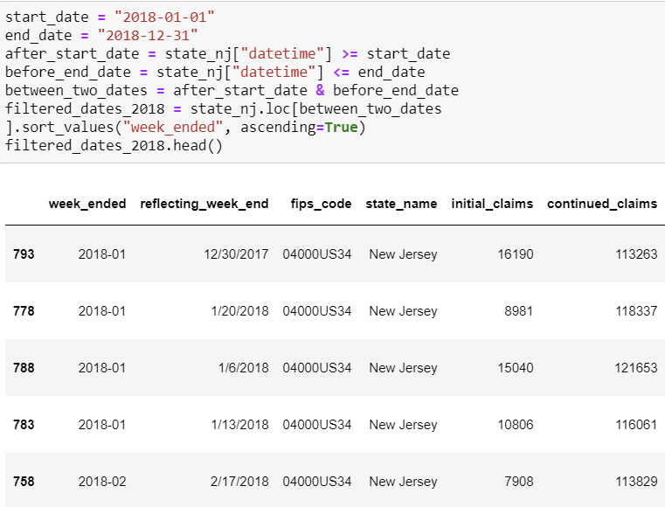
Impact on Employment Data Organizing

Slide 6
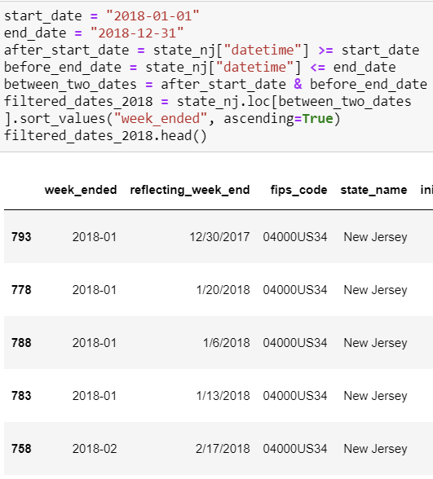
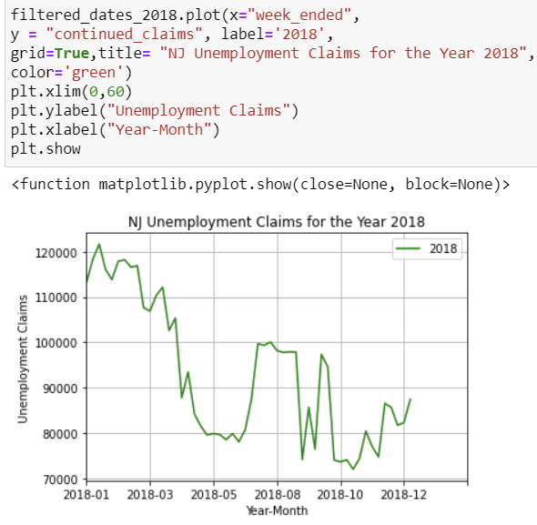
Impact on Employment Data Organizing

Slide 7
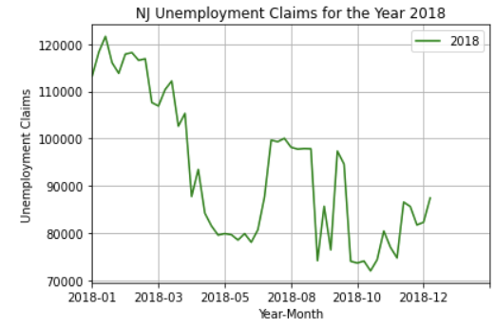
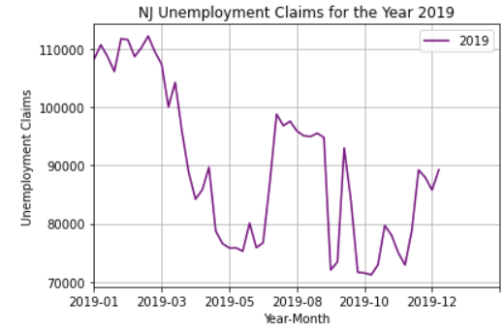
Unemployment Impact Comparison 2018 vs 2019

Slide 8
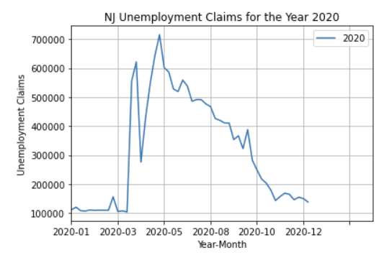
Unemployment Impact Comparison 2019 vs 2020

Slide 9
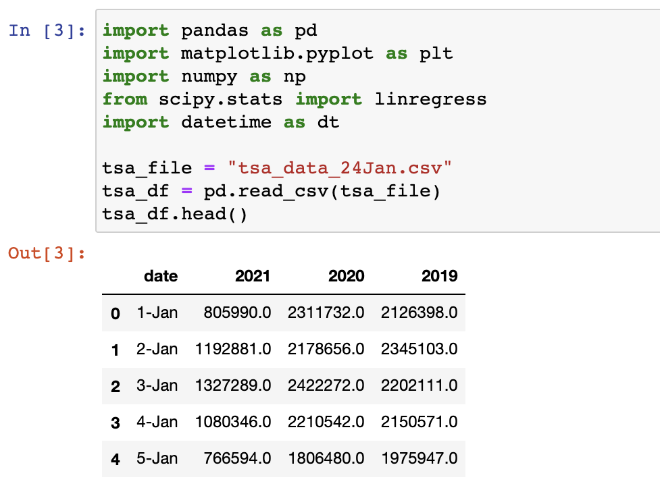
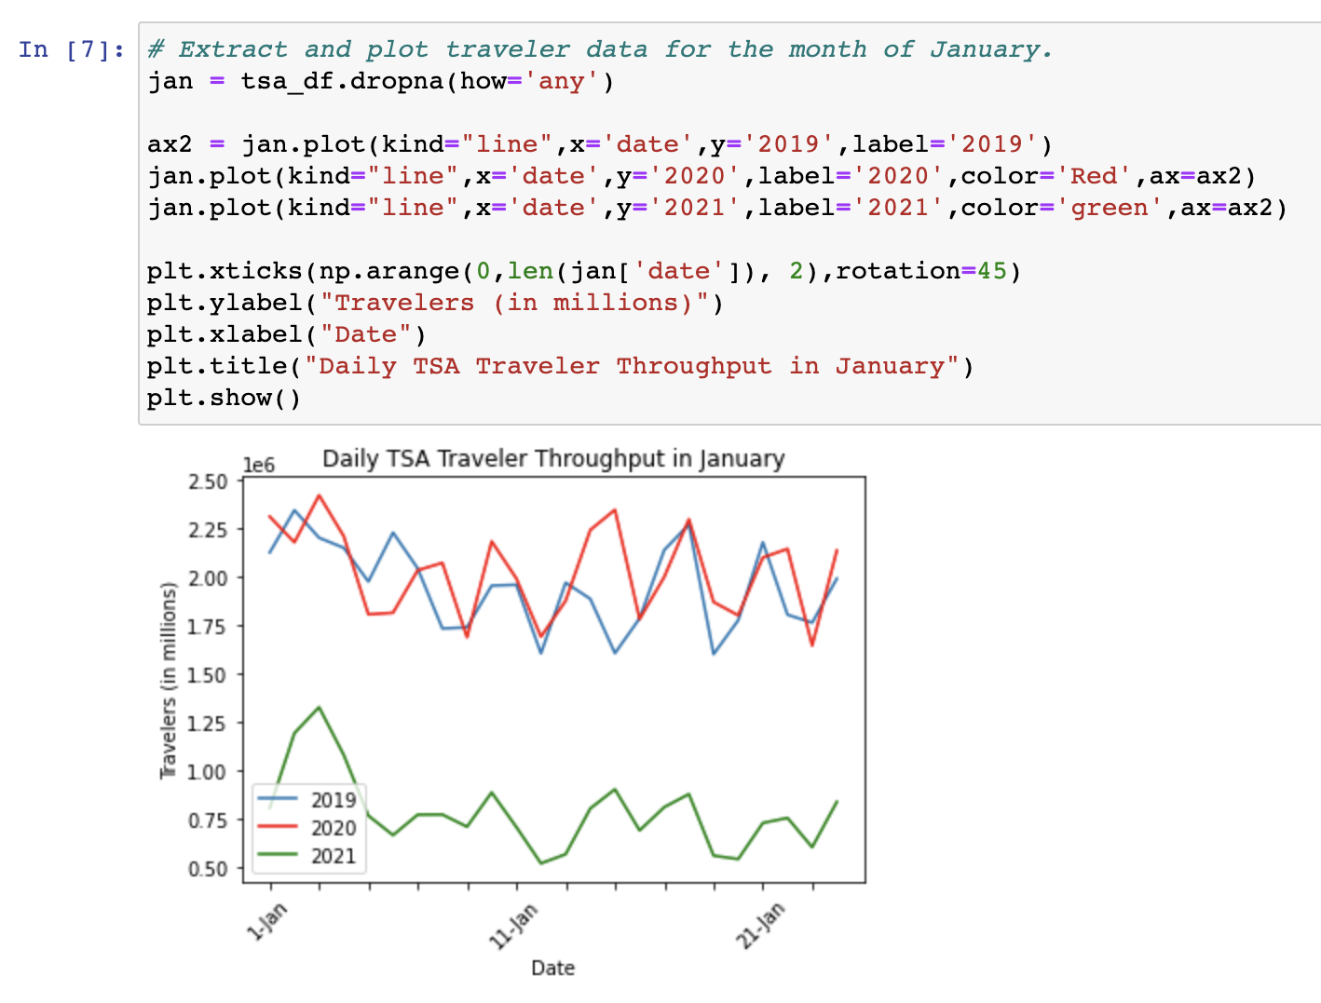
TSA Traveler Data for January
Notes:
Elaborate on the questions you asked, describing what kinds of data you needed to answer them, and where you found it
-What was the effect COVID had on flight travel? Needed TSA data
Describe the exploration and cleanup process. Discuss insights you had while exploring the data that you didn't anticipate. Discuss any problems that arose after exploring the data, and how you resolved them.
-CSV was entered manually using Excel, uploaded to Jupyter
- Data for February was missing

Slide 10
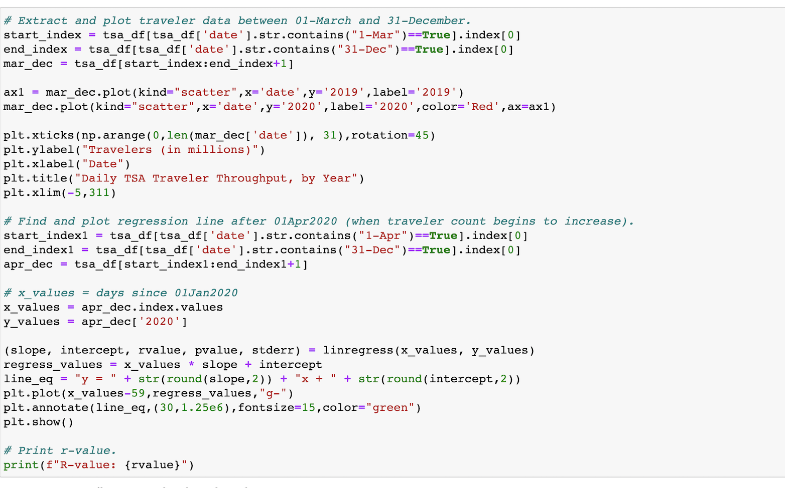
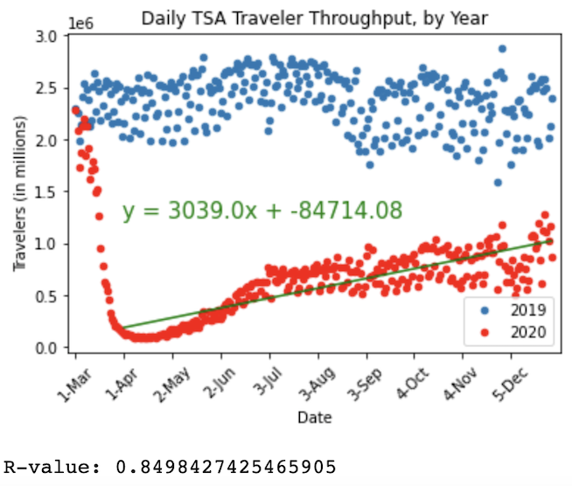
TSA Traveler Throughput: Effects of COVID-19
Notes:
Elaborate on the questions you asked, describing what kinds of data you needed to answer them, and where you found it
-When can we expect a return to normalcy? Needed TSA data from COVID as well as a baseline (2019 average)
Describe the exploration and cleanup process. Discuss insights you had while exploring the data that you didn't anticipate. Discuss any problems that arose after exploring the data, and how you resolved them.
-Linear regression was performed but only after TSA checks began to increase (for simplicity I chose 01Apr)

Slide 11
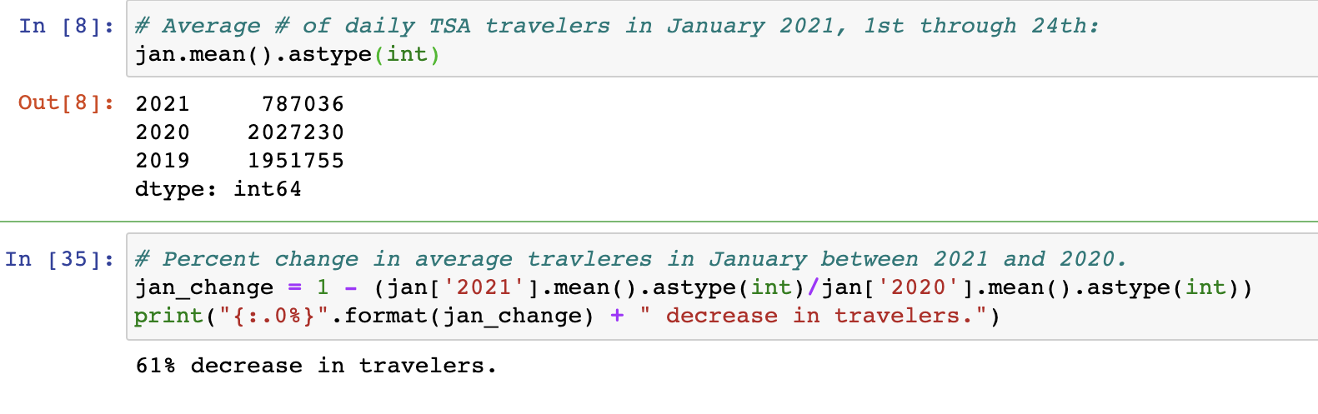
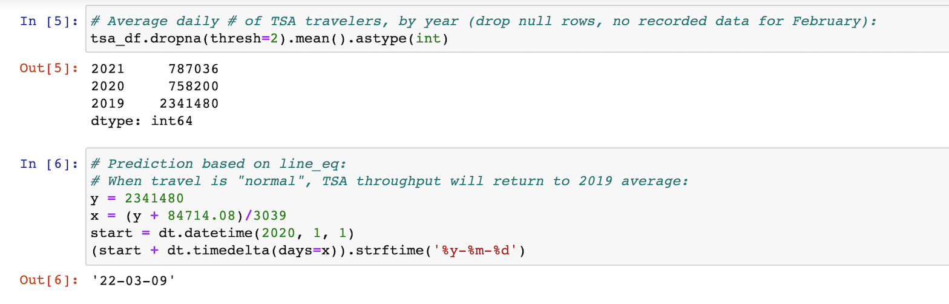
Return to Normalcy: Date Prediction Based on TSA Data
Notes:
Discuss your findings. Did you find what you expected to find? If not, why not? What inferences or general conclusions can you draw from your analysis?
-Predicting that airline travel won’t recover for over a year, but this will depend on many more factors
-Because there’s a decent positive correlation in travel throughput over time, this is a good star
Discuss any difficulties that arose, and how you dealt with them
Discuss any additional questions that came up, but which you didn't have time to answer: What would you research next, if you had two more weeks?

Slide 12
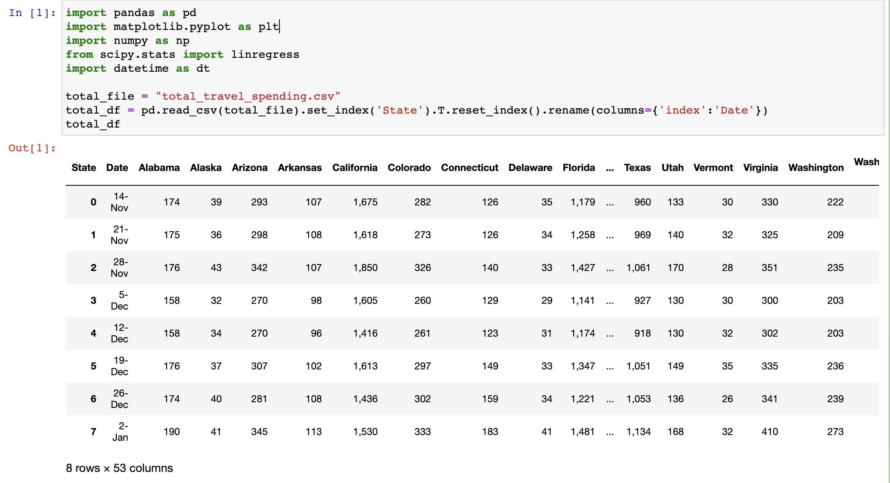
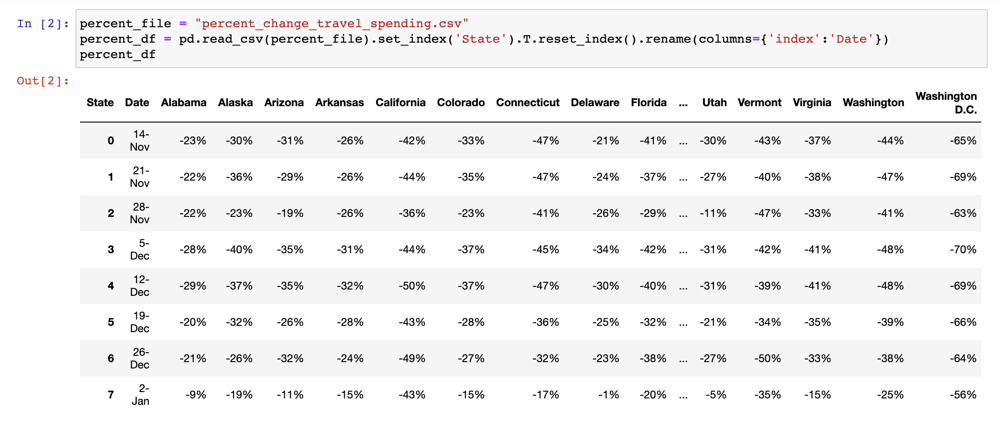
Travel Spending Data, By State: Totals + %Change
Notes:
Elaborate on the questions you asked, describing what kinds of data you needed to answer them, and where you found it
-What was the effect COVID had on travel spending? Specifically in NJ? UStravel.org (all modes of transport, by State)

Slide 13
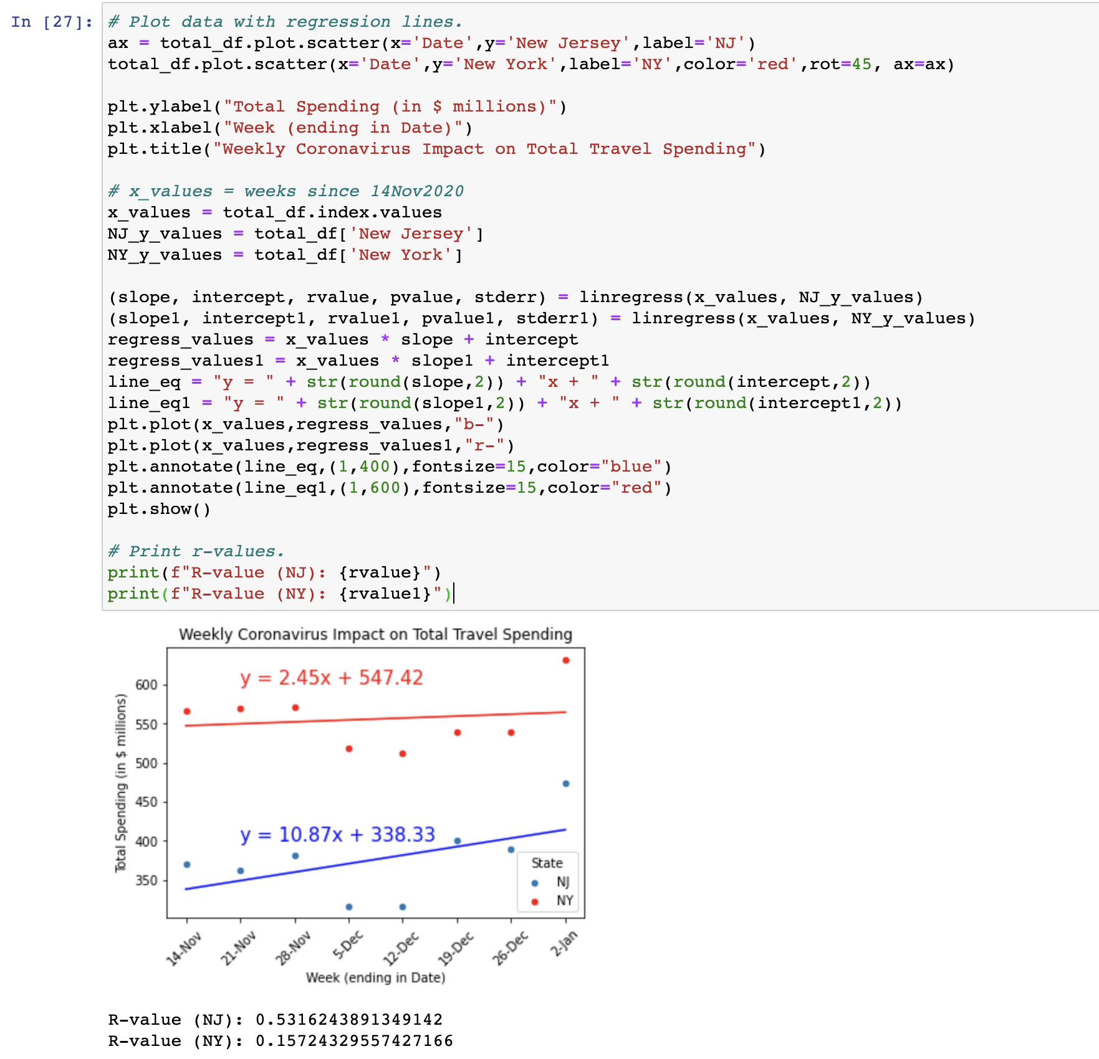
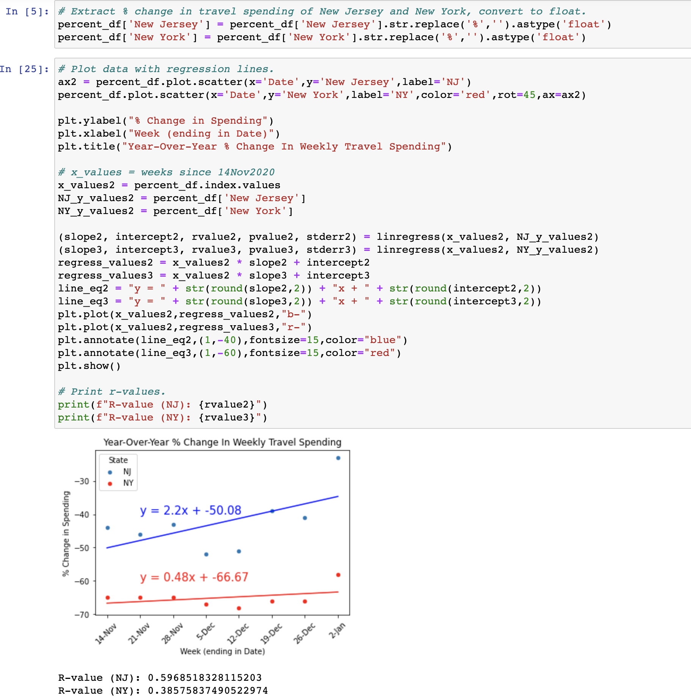
COVID-19 on NJ/NY Spending: 14Nov2020 - 02Jan2021
Notes:
Describe the exploration and cleanup process. Discuss insights you had while exploring the data that you didn't anticipate. Discuss any problems that arose after exploring the data, and how you resolved them.
- Linear regressions. I chose NJ and NY as a comparison (they are neighboring states that share many modes of travel)
Elaborate on the questions you asked, describing what kinds of data you needed to answer them, and where you found it
-When can we expect a return to normalcy?

Slide 14
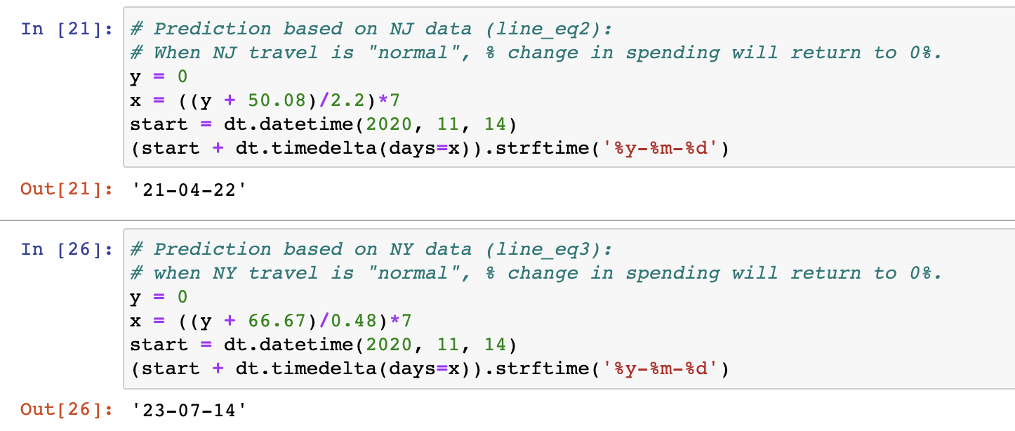
Return to Normalcy: Predictions Based on Spending Data
Notes:
Discuss your findings. Did you find what you expected to find? If not, why not? What inferences or general conclusions can you draw from your analysis?
-Could imply that a larger loss in travel spending indicates a longer return to normalcy (NJ will return to travel before NY)
-Hoping for stronger correlations over time, the dataset was only over the last weeks of 2020 (limited)
Discuss any difficulties that arose, and how you dealt with them
Discuss any additional questions that came up, but which you didn't have time to answer: What would you research next, if you had two more weeks?

Slide 15
NJ Changes in Mobility
Analyzing the impacts of Covid on mobility across NJ during the holidays. The period of time defined as “holidays” are the US Thanksgiving Holiday weekend and the last two weeks in December.
The datapoint presented are the staying at home numbers.
The dataset source is : US Dept of Transportation https://data.bts.gov/Research-and-Statistics/Trips-by-Distance/w96p-f2qv

Slide 16
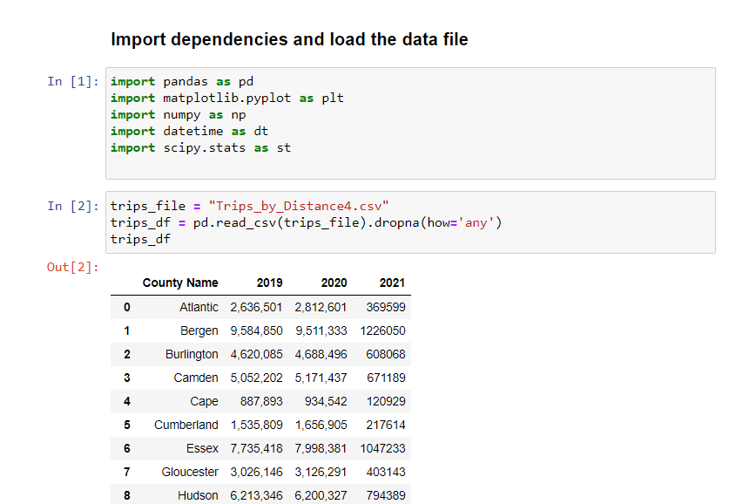
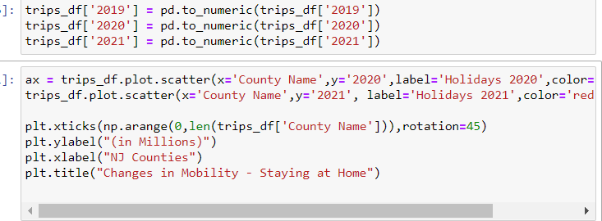
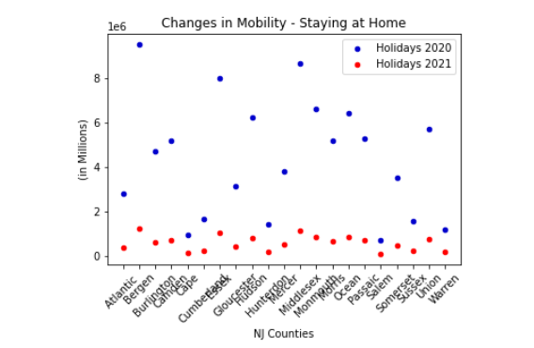

Slide 17
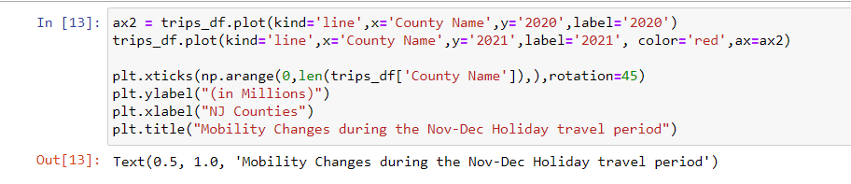
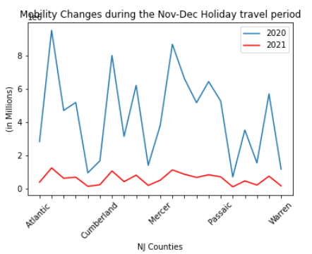

Slide 18
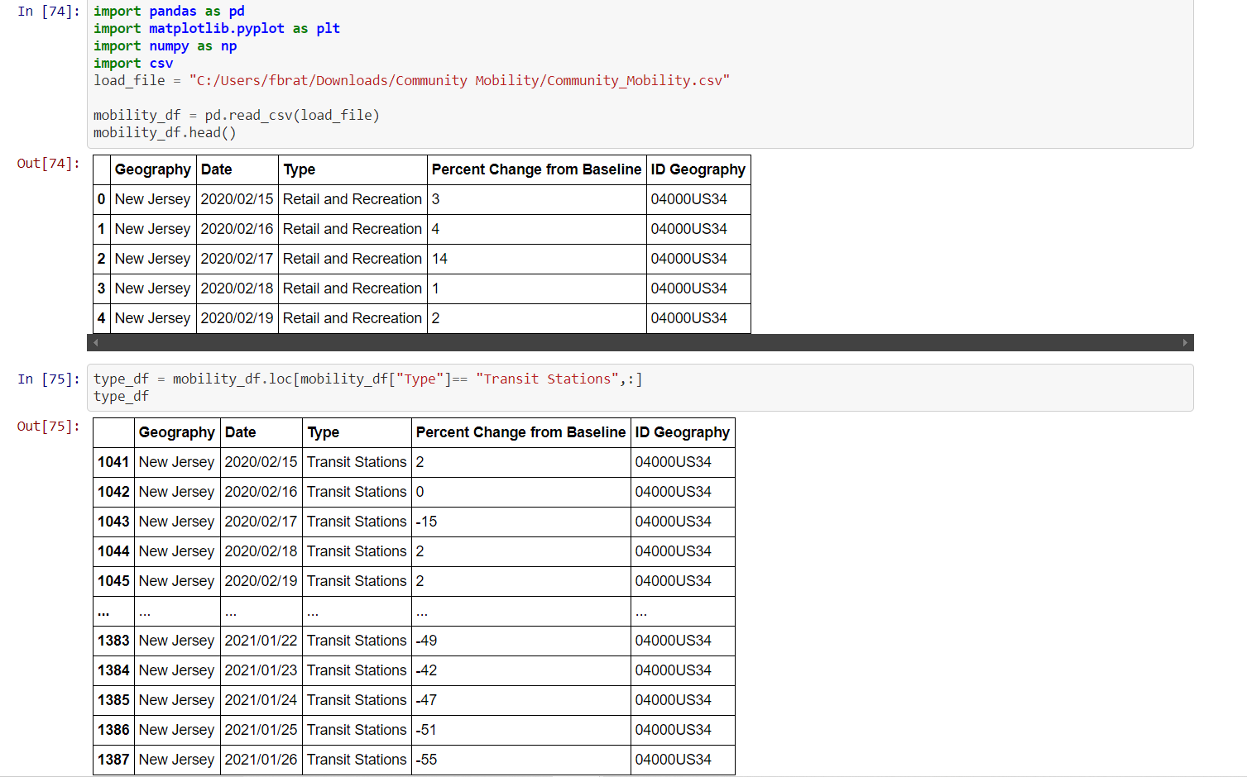
Transit Stations Data Filtering

Slide 19
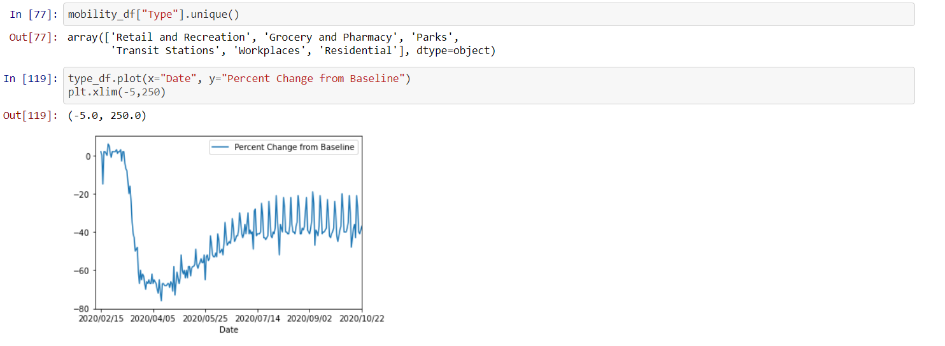

Slide 20
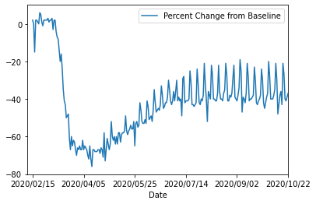
Covid 19 affects on NJ transit Stations
Notes:
This chart presents movement trends over time in the state of New Jersey for usage data of transit stations
Since the official announcement that the USA was in a pandemic, the usage of transit stations(buses, taxi, and trains) has diminished greatly. As show, usage rates from mid February up to late Spring shrunk considerably due to the mandatory quarantine issued countrywide. We can infer that social distancing factors(such as brandishing masks, hand sanitizers, staying approximately 6 feet apart from any individual) have cause an increase in transit usage

Slide 21
Conclusions
Our findings were to be expected as the circumstances and events are rather recent.
The resulting data extracted demonstrated that after initial dips a phase of recovery has been noted beginning Summer 2020.
There was difficulty in defining a quantitative baseline for normalcy.
With additional time we would:
Explore causal factors explaining recovery aspects (e.g. drops in unemployment claims)
Analyze the household spending activities (e.g. what are people spending on?)
Notes:
Did you find what you expected to find? If not, why not? What inferences or general conclusions can you draw from your analysis?
* Discuss any difficulties that arose, and how you dealt with them
* Discuss any additional questions that came up, but which you didn't have time to answer: What would you research next, if you had two more weeks?

Slide 22
Resources - Q&A
https://datausa.io/profile/geo/new-jersey#:~:text=Median%20Household%20Income,-%2481%2C740&text=Households%20in%20New%20Jersey%20have,represents%20a%202.06%25%20annual%20growth.
https://www.ustravel.org/sites/default/files/media_root/document/TE_Coronavirus_WeeklyImpacts_01.22.21.pdf
https://www.ustravel.org/toolkit/covid-19-travel-industry-research
https://www.tsa.gov/coronavirus/passenger-throughput
https://data.bts.gov/Research-and-Statistics/Trips-by-Distance/w96p-f2qv
https://www.bloomberg.com/graphics/2020-united-states-coronavirus-outbreak/
COVID-19: How We're Protecting You | NJ TRANSIT | New Jersey Transit Corporation | New Jersey

